Slide 1


Pivotal Cloud Foundry App Fundamentals

Slide 2
Draft 1
Still awaiting feedback from complete SME team
NOTE: We use several slides from the PCF Basics and Arch 301 presentation. We need to keep them in sync.

Slide 3
Agenda
Push / Bind / Scale
CLI, Manifests, API & Aps Mgr
Orgs, Spaces, Users & Quotas
Buildpacks
Logging
Auto scaling
Domains and routes
Basic Troubleshooting
Basic Services Overview
Blue/Green Upgrades and DB Migrations
Notes:
We’re introducing BOSH in the PCF Basics and Architecture 301 because BOSH is the tool that deploys PCF. It deploys PCF Elastic Runtime and PCF Services.

Slide 4
Pivotal Cloud Foundry Architecture
Platform Runtime (Elastic Runtime)
Services
Routing
Container Scheduling
Service Discovery
Configuration
Database
Application Framework
Big Data
12 Factor Apps
Microservices
RESTful Services
Circuit Breakers
Object Storage
Mobile
Spring Boot
Ruby on Rails
Node.js
.NET
Build CI
Logging & Metrics
Messaging
User Provided
Operations
Zero Downtime Deployments
Failover & Recovery
Scaling
Security Patching
Platform
Upgrades
Notes:
Before diving into BOSH we introduce the major components of the platform. Then we explain the platform infrastructure automation capabilities in the context of our structured (or opinioned) platform. The following BOSH sections would explained in more detail.
PCF is made of 3 major components – Operations (Ops Manager), Platform Runtime (Elastic Runtime) and Services. All, mostly deployed, by BOSH
Now we’ll briefly talks about the components

Slide 5

CF Push, Bind and scale
Notes:
THIS SECTION INCORPORATES SLIDES FROM “PCF Basics and Arch 301” Deck

Slide 6

Deploying an Application
Platform Runtime (Elastic Runtime)
Blobstore
Service
credentials
Upload app bits and metadata
DB
push app
+ app MD
Cloud Controller
Service Broker Node(s)
Create and bind services
Stage application
Deploy application
Manage application health
Router
Container Management - DIEGO
Cell
DEA
Brain
DEA
DEA
+
=
Notes:
We keep the cf push workflow simple and don’t get into the details of DIEGO. We only keep the BRAIN and Cell.
Cloud Foundry PaaS – Pushing an Application with Diego
App deployment: what has changed?
1- Domain specific (notion of apps) -> Abstractions (notions of LRPs and Tasks). App staging is a Task. App start is launching a LRP.
2- Platform specific (linux) -> Supporting multi platform (Windows & Linux) enabling running also .NET apps, thanks to our new Container implementation: Garden
What’s more, there is a 3rd workflow supported: Docker on Linux
3- New Auction-based workload scheduler: Cloud Controller no longer in charge of deciding where AIs are spun up. Auctioneer manages the process running an auction, making it more optimized.
With Diego in place, more loosely-coupled components take part in the process, stripping down the Cloud Controller from too many previous responsibilities, making it easier to maintain and evolve the entire architecture.
The Cloud Controller handles the routing of client requests internally through the Cloud Controller Bridge. It also manages the Blobstore to store packages and droplets and the DB to store App Metadata and Service credentials. Blobstore could be internal or external, depending on the setup.
A service gateway provides an interface for services (native or external).
More in the next slide about the Cloud Controller Bridge (CC-Bridge), the Bulletin Board System (BBS) and the Auctioneer in the next slide
Apps run in a CELL, part of the new Cloud Foundry Runtime, called Diego
Routers manage application traffic.
Diego handles all health management for apps (now LRPs), through a series of single-purpose components: Nsync (part of the CC-Bridge), BBS (part of Diego DB) and the Converger (part of the Diego Brain)
Apps are accessed directly through the router while web and CLI clients (e.g., vmc, STS) access Cloud Controller via RESTful services.

Slide 7
Creating and binding services
Service
credentials
DB
CLI
create service (HTTP)
Cloud Controller
create service (HTTP)
Service
Broker
reserve resources
Data
Service
Router
bind service (HTTP)
bind service (HTTP)
obtain connection data
Platform
Runtime
Notes:
NOTE: THIS SLIDE IS THE SAME WE USE IN THE PCF Basic and Arch 301 presentation – KEEP THEM IN SYNC

Slide 8
Staging an Application
Blobstore
DB
Cloud Controller
Cell
System
Buildpacks
Detect
Compile
Upload
Router
Yes
No
+
=
Platform Runtime
Notes:
The purpse is to simple explain our staging process and introduce buildpacks. We’re not getting into the details of DIEGO.
https://github.com/cloudfoundry-incubator/diego-design-notes#app-lifecycles

Slide 9
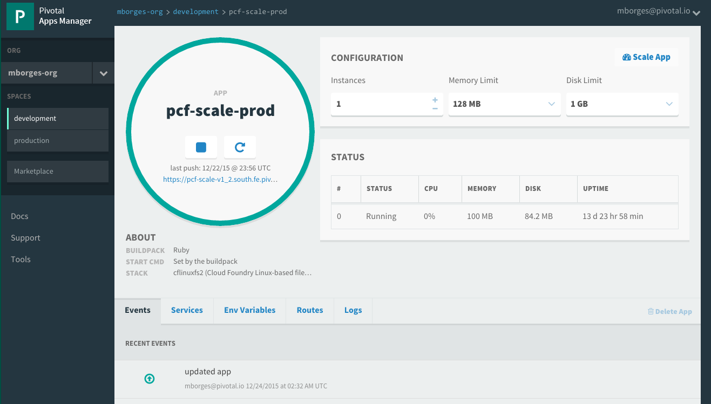

Getting your application to scale
Can be done via CLI:
At deployment time (via manifest.yml or as a modifier to cf push)
During run time without interrupting operations (via cf scale --instances 10)
Can also be done via Apps Manager
© Copyright 2013 Pivotal. All rights reserved.
Notes:
TDB: Update picture – what about slide showing visually

Slide 10
The App-Container Approach - Scaling
Blobstore
Cloud Controller
Container Management - DIEGO
Router
Access App
Brain
Cell
Cell
Cell
Platform Runtime
Notes:
https://github.com/cloudfoundry-incubator/diego-design-notes
At the core of Diego
A distributed scheduling algorithm which orchestrates where containers go and hence where application instance processes are run
Optimizing for application workloads
Implements Demand Driven scheduling of workload
Auctioneer says "I have N pieces of work, who wants them?"
Worker cells then join an auction and the winning cell of each auctioned-off piece of work gets that piece of work
Components of Diego
Tasks & Long Running Processes (LRPs)
Tasks: are processes that are run once and have a finite running time. This might be a script or job to process a piece of data
LRP: This might be a web-server or some other service that continuously accepts input and processes
Tasks are not included in Auction
Cells
Cells are where the Tasks and LRPs are run
These are most analogous to DEAs in the current Cloud Foundry architecture.
Generally one Cell per VM
Brain – implements the core scheduling (auction algorithm) functionality of Diego
Bulletin Board System/Store (BBS)
Where state of Diego cluster is stored
Up to date cache of cluster state
“Holds” CF actions
Start/Stop instances
Start one-off task processes
Backed by ETCD which acts as consistent store
Components of Diego Brain
Auctioneer – holds auctions for LRPs and Tasks
Also determines which instances are removed when scaling down
Converger - Keeps cluster state consistent using eventually consistent model
Ensures cluster state is consistent with the desired state, that is, performs convergence
Provides fault tolerance for Tasks and LRPs
Updates BBS with state of cluster
Places requests on BBS
Metric Server – Reads from Metron agents, publishes them to Doppler
Components of Diego Cell
Rep - Represents Cell in Diego
Mediates all communication with BBS where cluster state is maintained
Participates in auction to accept Tasks/LRPs
Runs Tasks & LRPs by working with Executor
Executor –
Implements HTTP API to Create and Delete Containers
Implements Executor Actions such as Run, Download, Upload, Parallel etc
Streams Stdout & Stderr to Metron agent running in the Cell
Garden – the Linux container for Diego
Garden API – the Linux Garden API implementation
Garden-Linux – the Linux container backend implementation
Isolates network, disk, memory, CPU; performs resource management
Runs droplets, tasks, other containers (Docker)
Metron Agent - Forwards application logs and application/Diego metrics to doppler (loggregator)

Slide 11
CLI, Manifest, API, Apps Manager
Notes:
THIS SECTION INCORPORATES SLIDES FROM “PCF Basics and Arch 301” Deck

Slide 12
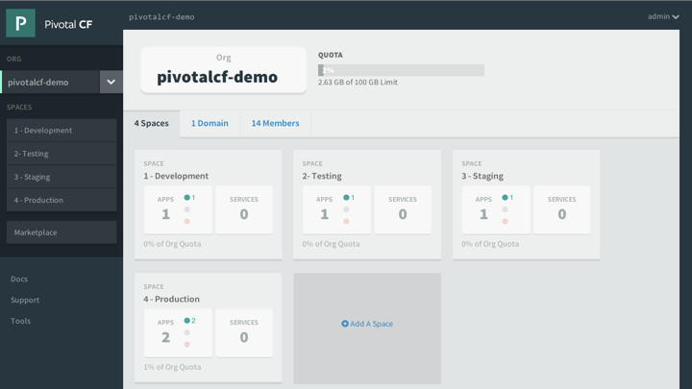
Platform Runtime - Pivotal Apps Manager
Manage Organizations, users, applications and Spaces
Monitor applications logs, services and routes
Access Service Marketplace, create services and bind to applications
Notes:
http://docs.pivotal.io/pivotalcf/console/index.html
This picture allows us to walk thru the basics of Apps Manager. PCF Elastic Runtime self-service UI. ERS is a multi-tenant platform that can be logically divided into Organization and further into spaces. Quotas ensure resources are managed and Spaces further divides organization to manage and control access to application and services.

Slide 13
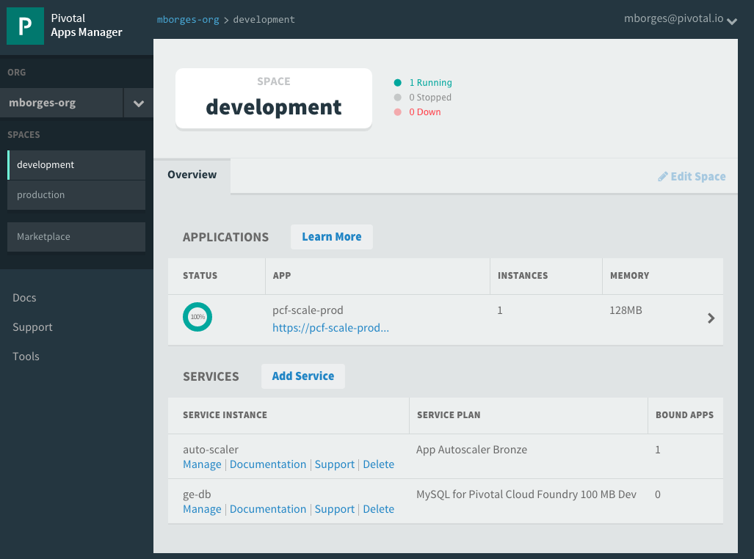
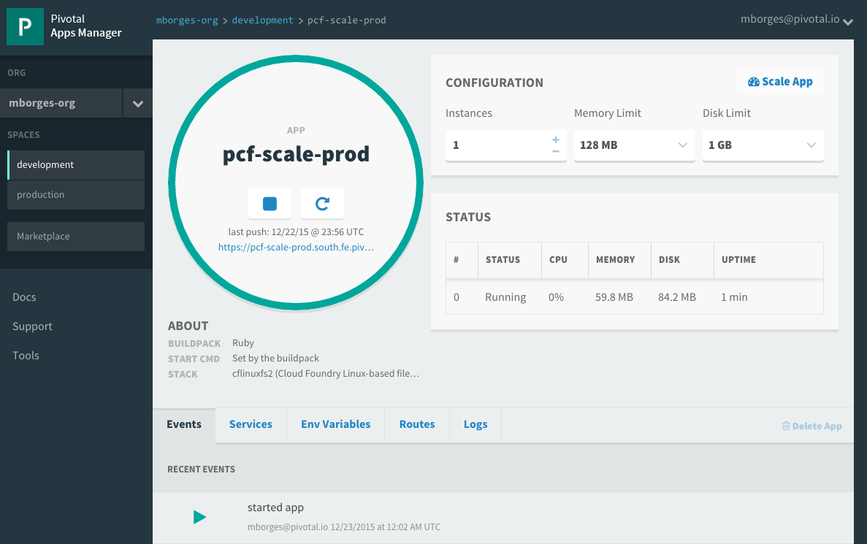
Pivotal Apps Mgr. – App View
Drill into a space to see all application and services instances
Then drill into an application to see configuration, status, event, logging, routes, environment variables and service instances bound to the application
Notes:
http://docs.pivotal.io/pivotalcf/console/index.html
This picture allows us to show the space view that provides quick overview of all applications and services target to it. Further application detail can be obtain by drilling into specific application. Notice that services can be managed via the quick manage link. The number of bounds apps is also showed.

Slide 14
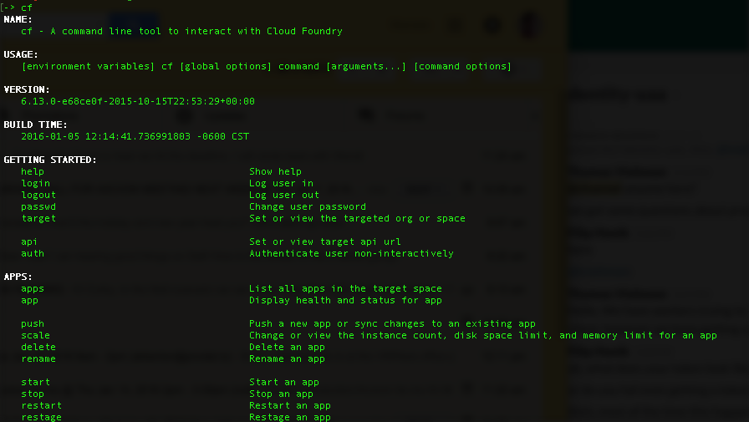
CLI – Command Line Interface
Command line utility providing easy access to the Pivotal CF commands.
Scriptable
Fully documented (cf –help)
Notes:
http://docs.pivotal.io/pivotalcf/console/index.html

Slide 15
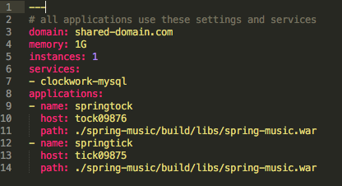
Manifest Files
Application manifests tells cf push what to do with applications
From how many instances to create and how much memory to use.
Help automate deployment, specially of multiple apps at once
Can list services to be bound to the application
YAML format – http://yaml.org
Notes:
https://docs.pivotal.io/pivotalcf/devguide/deploy-apps/manifest.html
YAML format - Default name is manifest.yml

Slide 16
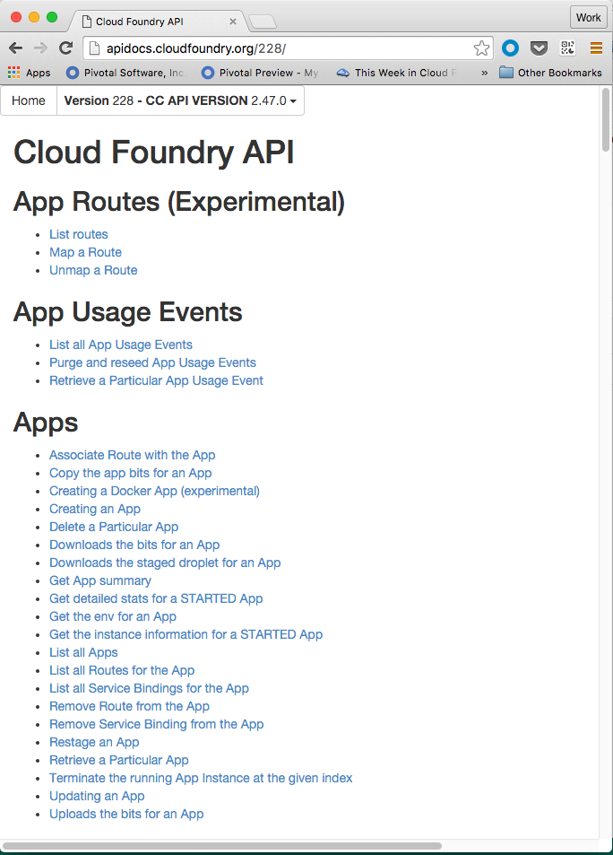
Cloud Controller API
Cloud Controller component of Elastic Runtime manages all Cloud Foundry APIs
CF CLI and other clients like Apps Manager directly call this API
Before accessing the CC API, you must get an access token from the ERS component called User Account and Authentication (UAA) server
http://apidocs.cloudfoundry.org
Notes:
http://docs.pivotal.io/pivotalcf/console/index.html

Slide 17
Orgs, Spaces, Users and Quota
Notes:
Multi-tenant platform

Slide 18
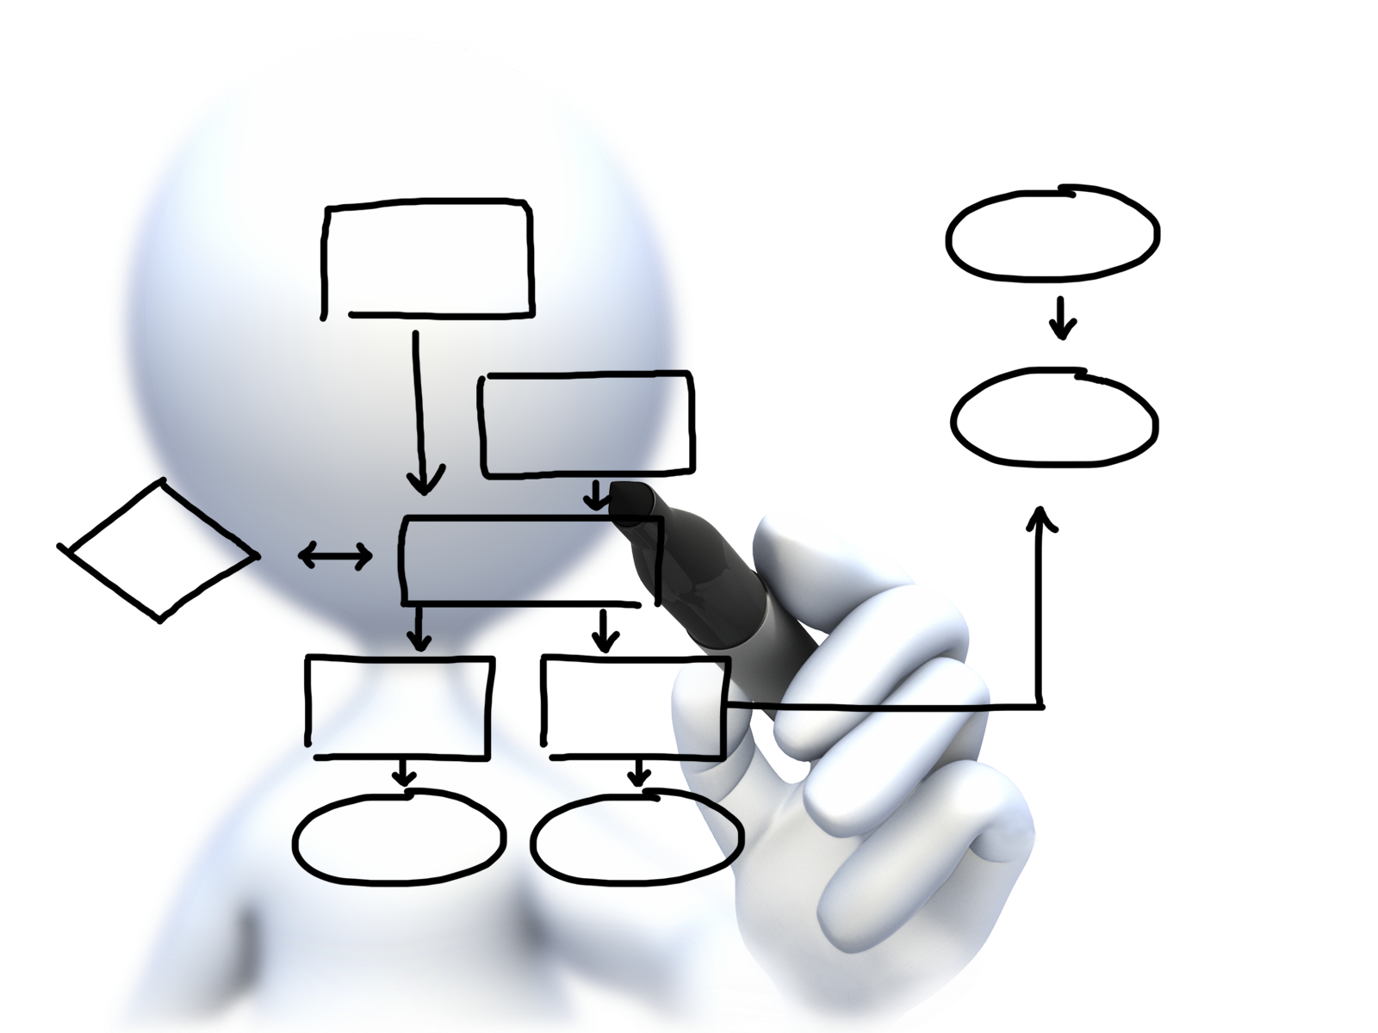
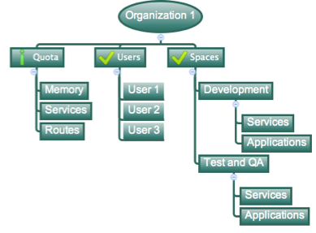
Orgs, Spaces, Users and Quotas
Cloud Foundry Installation
Notes:
https://docs.pivotal.io/pivotalcf/concepts/roles.html
Cloud Foundry uses role-based access control (RBAC), with each role graning permissions in either an org or a space.
Orgs: An org is a development account that an individual or multiple collaborators can own and use. All collaborators access an org with user accounts. Collaborators in a org share a resource quota plan, applications, services availability, and custom domains.
User Accounts: Represents an individual person within the context of a Cloud Foundry Installation. A user can have different roles in different spaces within an org, governing what level and type of access they have within the space.
Spaces: Every application and service is scoped to a space. Each org contains at least one space. A space provides users with access to a shared location for application development, deployment, and maintenance. Each space role applies only to a particular space.
Roles and Permissions (Maybe on its own slide): A user can have one or more roles. The combination of these roles defines the user’s overall permissions in the org and within specific spaces in that org.

Slide 19
Organizations
Top-most administrative unit
Logical division division within a Pivotal Cloud Foundry Install / Foundation
Typically a company, department, application suite or large project
Each organization has its own users and assigned quota
User permissions / Roles are specified per space within an organization
Sub-divided into spaces
Notes:
TDB: layout

Slide 20
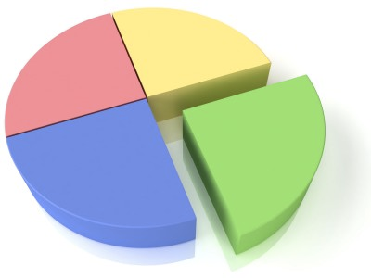
Quotas and Plans
Different quota limits (e.g. small, enterprise, default, runaway) can be assigned per Organization
Quotas defines
Total Memory
Total # of services
Total # of Routes
Sub-divided into spaces
Notes:
TDB: layout
https://docs.pivotal.io/pivotalcf/opsguide/change-quota-plan.html
Note: Documentation seems very outdated and thin on this subject. Do some research
Quota plans are named sets of memory, service, and instance usage quotas. For example, one quota plan might allow up to 10 services, 10 routes, and 2 GB of RAM, while another might offer 100 services, 100 routes, and 10 GB of RAM. Quota plans have user-friendly names, but are identified by unique GUIDs.
Quota plans are not directly associated with user accounts. Instead, every organization has a list of available quota plans, and the account admin assigns a specific quota plan from the list to the organization. Everyone in the organization shares the quotas described by the plan.

Slide 21

Spaces
Logical sub-division within an organization
Users authorized at an organization level can have different roles per space
Services and Applications are created / target per Space
Same service name can have different meaning per space
Notes:
TDB: layout

Slide 22

Users and Roles
Users are members of an organization
Usually they are operators or developers (not application end users)
Users are sent an email invite and asked to create an account
Users have specific organization and space roles
Organization roles grant permissions in an organization
Space roles grant permissions in a particular space
A combination defines the user’s overall permissions
Notes:
TDB: layout

Slide 23
Buildpacks
Notes:
THIS SECTION INCORPORATES SLIDES FROM “PCF Basics and Arch 301” Deck

Slide 24
Platform Runtime – Application Frameworks
Container image
application layer
PCF buildpacks provide full support and maintenance for 3 of the 4 layers of the container stack
Devs can focus on just the app code
PCF creates the container image for you
runtime layer*
Dev Supported
PCF Supported
OS image
App container
Ops Supported
linux host & kernel
* Devs may bring a custom buildpack
Notes:
Introduction to buildpacks
Here we can compare and contrast with other container solutions like docker. We can bring up the advantages on the fact the container is built on the fly and that the buildpack provides consistency in building, updating and patching container images. Sometimes infrastructure people get’s concerned about the fact we bring our own OS images (stemcells) in regards to their “special” security and other needs. We need to find a subtle way to explain these “special” needs are often part of the problem. We should defer any detail security discussion as it can get hairy.

Slide 25
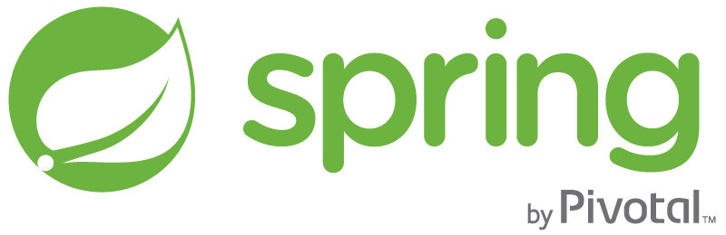
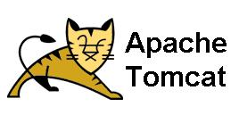
Runtime Benefits With PCF
runtime layer
6 Language Runtimes Maintained with Buildpacks
Java, Node, Python, PHP, Ruby, Go
Enterprise Support with Buildpacks
or Docker Images
Enterprise Middleware Support
Apache Tomcat Support from #1 Committer
Enterprise Framework Support
Spring is the #1 Enterprise Java Framework

Slide 26
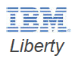
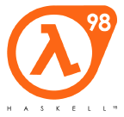

Custom Buildpacks
Cloud Foundry Community provides buildpacks for other languages
Or write your own
Usually by forking / adapting an existing buildpack
For list of CF Community Buildpacks
https://github.com/cloudfoundry-community/cf-docs-contrib/wiki/Buildpacks
Notes:
https://github.com/cloudfoundry-community/cf-docs-contrib/wiki/Buildpacks

Slide 27
LOgging
Notes:
THIS SECTION INCORPORATES SLIDES FROM “PCF Basics and Arch 301” Deck

Slide 28
Log Streaming and Aggregation
App Developers can tail their application logs or dump the recent logs from the CF CLI, or stream these to a third party log archive and analysis services
Operators and administrators can access the Loggregator firehose, the combined stream of logs from all apps, plus metrics data from CF components
Operators can deploy ‘nozzles’ to the firehose. A nozzle listens to the firehose for specified events and metrics. E.g syslog or datadog nozzle
Notes:
https://docs.pivotal.io/pivotalcf/loggregator/nozzle-tutorial.html
Avery Application instance starts streaming logs immediately
“Loggregator” component aggregates logs and streams back to different outputs
Streaming can be send directly to Splunk or other log aggregation and analytics tools

Slide 29
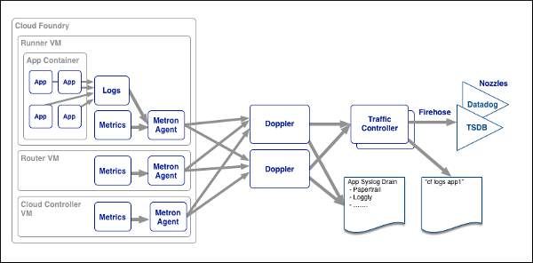
Loggregator Components
Notes:
https://docs.pivotal.io/pivotalcf/loggregator/architecture.html

Slide 30
Auto scaling
Notes:
THIS SECTION INCORPORATES SLIDES FROM “PCF Basics and Arch 301” Deck

Slide 31
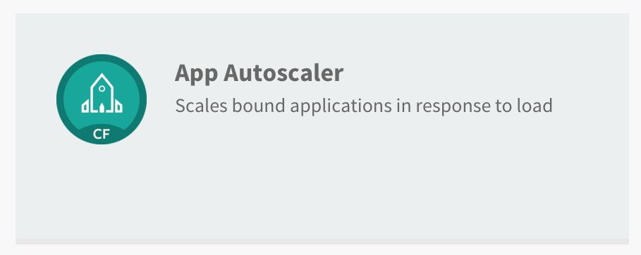
Available via the Marketplace

Slide 32
Service Plans
Bronze and Gold service plans
Major difference between plans is how often app is monitored
Bronze - every 5 minutes
Gold - every 30 seconds

Slide 33
Service Plans
Both plans provide:
Scaling app up and down according to user-provided load parameters
Scale based on one-time event or recurring schedules
Service management dashboard for configuration

Slide 34
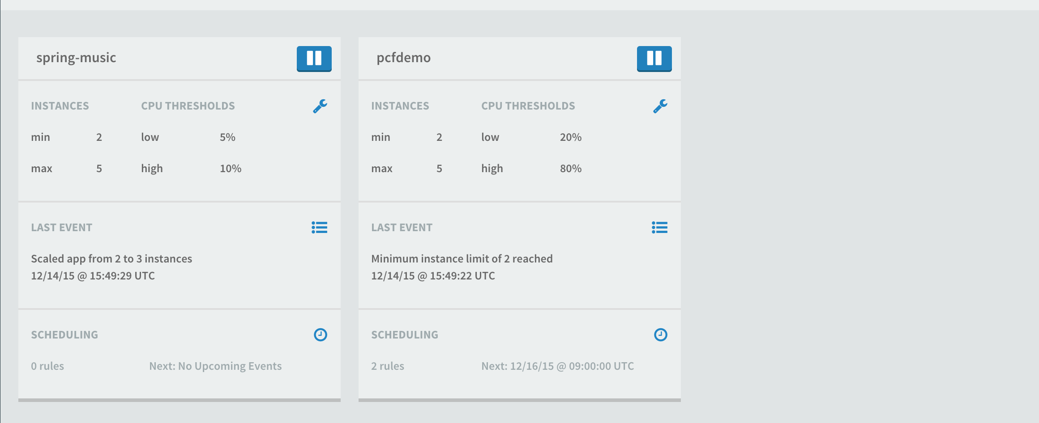
Service Management Dashboard

Slide 35
Domains and routes
Notes:
THIS SECTION INCORPORATES SLIDES FROM “PCF Basics and Arch 301” Deck

Slide 36
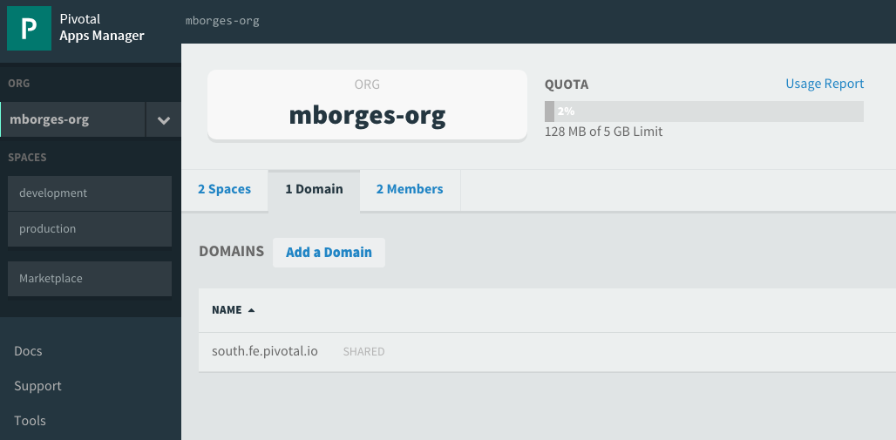
Domains
Each Cloud Foundry installation has a default app domain
Domains provide a namespace from which to create routes
Requests for any routes created from the domain will be routed to Elastic Runtime.
Domains can be shared or private in regards to PCF organizations
Notes:
https://docs.pivotal.io/pivotalcf/devguide/deploy-apps/routes-domains.html
Picture of PCF architecture HAProxy and Router using domain namesdns

Slide 37
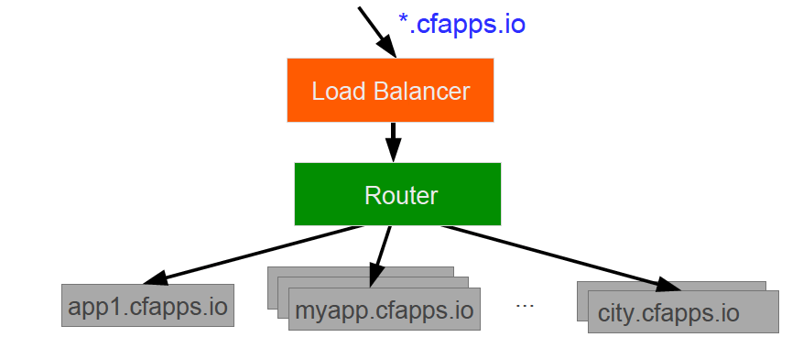
Domains – Behind the Scenes
A wildcard entry (*) is added to the DNS for the app domain
That DNS entry points to a load balancer (or Cloud Foundry’s HA Proxy), which points to the Cloud Foundry’s Router
The Router uses the subdomain to map to application instance(s)
Notes:
https://docs.pivotal.io/pivotalcf/devguide/deploy-apps/routes-domains.html
Picture of PCF architecture HAProxy and Router using domain namesdns

Slide 38
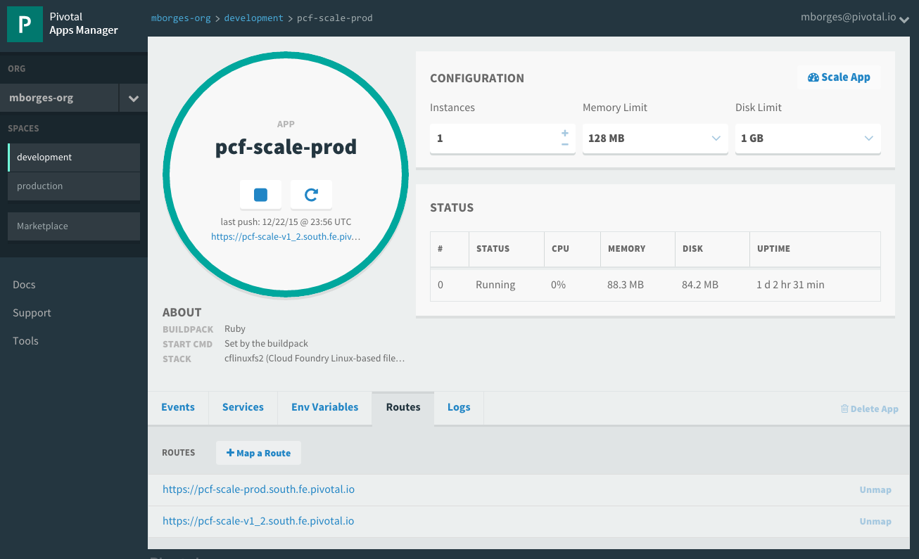
Routes
HTTP requests are routed to apps pushed by associating an application with a URL, know as route
Many apps can be mapped to a single route resulting in load balanced requests
Routes belong to a space
Application can have multiple routes
Notes:
https://docs.pivotal.io/pivotalcf/devguide/deploy-apps/routes-domains.html
TDB: Consider adding a picture instead of just showing Apps Manager

Slide 39
Basic troubleshooting
Notes:
THIS SECTION INCORPORATES SLIDES FROM “PCF Basics and Arch 301” Deck

Slide 40
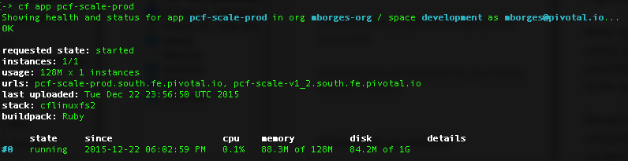
Health
Usage: cf app APP…
Show the running instances and health information for one or more applications
Example:

Slide 41
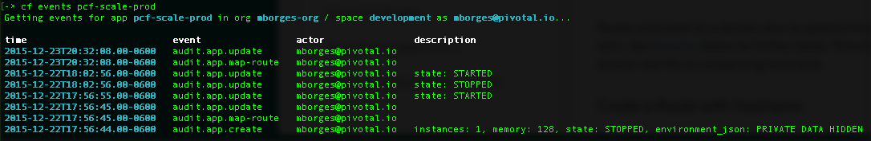
Events
Display application instance events (updates, crashes, …)
Usage: cf events [APP]
Example:

Slide 42
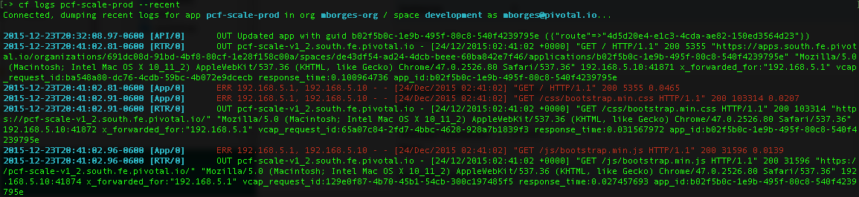
Logs
Print out an app's logs
Usage: cf logs [APP] Options: --recent Recent logs
Example:

Slide 43
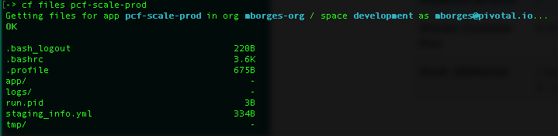
Files
Print out a list of files in a directory or the contents of specific files
Usage: cf files APP_NAME [PATH] Options: -i Instance
Example:

Slide 44

Diego for PCF SSH access to containers
> cf ssh my-awesome-app
SSH Proxy Server
✓ Authenticate
✓ Locate target container
✓ Connect to the ssh daemon
✓ Manage communication
DEA /CELL
App
App
App
App
Notes:
*Note: Make sure to mention that this functionality should be used only in case deeper troubleshooting is required. The integrity of the platform has to be kept…we don't want to enable snowflakes. Operations can control ssh access…see more details below:
Diego SSH is composed by:
Implementation of an ssh proxy server
A SSH daemon
CF CLI plugin
The SSH proxy is the user accessible endpoint. It is responsible for: authentication, locating target container, establish the connection to the daemon running inside the container and after the connection is established, it manages the communication between user’s ssh client and container’s daemon.
SSH daemon supports:
Command executions
Interactive shells
Local port fowarding
SCP
It is made avalalble on a file server and can be donwloaded for Diego LRPs that want to use it. For CF apps the daemon will be downloaded as part of the lifecycle bundle.
Config tru CLI:
App: enable_ssh
CF space: allow_ssh
OPS Manager:
CC: allow_app_ssh_access

Slide 45
Basic services overview
Notes:
THIS SECTION INCORPORATES SLIDES FROM “PCF Basics and Arch 301” Deck

Slide 46
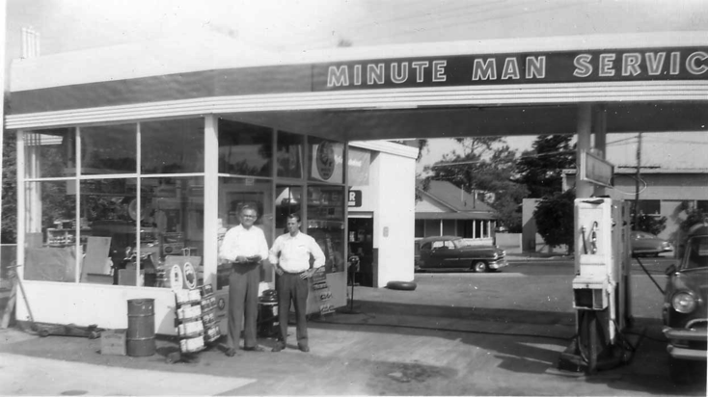
What is a Service?
Allows resources to be easily provisioned on-demand
Typically middleware and other “components” necessary for applications
Can be a persistent, stateful layer

Slide 47

Two Types of Services
Managed - Fully integrated, with fully lifecycle management
User-Provided – Created and managed external to the platform

Slide 48
Managed Services
Managed Services are integrated with Cloud Foundry by implementing a documented API for which the cloud controller is the client
Service Broker is a component which implements the required API.
Service brokers advertise a catalog of service offerings and service plans to Cloud Foundry, and receive calls from the Cloud Controller for five functions: fetch catalog, create, bind, unbind, and delete.
Notes:
http://docs.cloudfoundry.com/docs/running/architecture/services/writing-service.html
Find a good way to differentiate services provisioned by the platform or just managed (via service brokers) by the platform.
Service Broker API?

Slide 49
User Provided Service Instances
User-provided service instances are service instances which have been provisioned outside of Cloud Foundry
Behave like other service instances once created
Familiar commands (‘create-service’) provide service instance configuration (including credentials) to applications, eliminating the need to hard code service instance endpoints
Example: An Oracle database managed outside of, and unknown to Cloud Foundry
Notes:
http://docs.cloudfoundry.com/docs/using/services/user-provided.html

Slide 50
Blue/green deployment and db migration
Notes:
THIS SECTION INCORPORATES SLIDES FROM “PCF Basics and Arch 301” Deck

Slide 51
Blue-Green Deployments
Blue-Green deployment is an approach to upgrading application with minimal downtime.
It also enables easy rollback to the old version if the new version experiences problems
It works by keeping both versions online, and switching from the old version to the new version
live
traffic
app 1.0
app 1.0
live
traffic
app 1.1
app 1.1
Before
After
Notes:
https://docs.pivotal.io/pivotalcf/devguide/services/migrate-db.html
IMAGE FOUND ON GOOGLE – check

Slide 52
Blue-Green Deployments using Routes
Main idea: you always want myapp.cfapps.io to be good
Use routes to achieve this
Because you are in a single space, multiple application can use the same routes
myapp.cfapps.io
myapp.cfapps.io
app 1.0
app 1.0
app 1.0
myappdev.cfapps.io
app 1.1
myapp.cfapps.io
app 1.1
myapp.cfapps.io
app 1.1
Before
(working on version 1.1)
During
(version 1.1 is ready)
After
(done with version 1.0)
Notes:
https://docs.pivotal.io/pivotalcf/devguide/services/migrate-db.html
IMAGE FOUND ON GOOGLE – check

Slide 53
Slowly Turning on Traffic using Instances
Start with four instance of blue, one instance of green
80% of traffic will use version 1.0
Decrease blue instance, increase green instances as confidence builds
app 1.0
myapp.cfapps.io
app 1.0
app 1.0
app 1.0
app 1.1
app 1.1
myapp.cfapps.io
app 1.1
myapp.cfapps.io
app 1.1
app 1.1
Notes:
https://docs.pivotal.io/pivotalcf/devguide/services/migrate-db.html
IMAGE FOUND ON GOOGLE – check

Slide 54
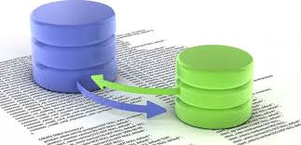
DB Migrations for Cloud Foundry Services
Migrate Once
Service instance credentials can be obtained using cf env
Migrate Occasionally
Create a schema migration cmd or script
Run it when deploying a single instance of the app
Redeploy the app with the original cmd
Migrate Often
Uses idempotent script to partially automate migrations. The script runs on the first application instance only
Notes:
https://docs.pivotal.io/pivotalcf/devguide/services/migrate-db.html
IMAGE FOUND ON GOOGLE – check
DB migration tools – flyway
https://blog.pivotal.io/labs/labs/db-migrations-spring-project

Slide 55
Open.
Agile.
Cloud-Ready.

Slide 56
Platform Runtime – Buildpacks
Buildpacks are responsible for preparing the machine image for an application
}
Application
Buildpack
Container
Libraries
Droplet
DEA
Runtime
Operating System
Notes:
Application Framework -

Slide 57
Log Aggregation and CF Components
Health Monitor
Syslog
Syslog Aggregator
Cloud Controller
Syslog
Logstash
Messaging (NATS)
Splunk
Syslog
Cell
Pivotal CF Elastic Runtime
…
Syslog
Notes:
Libraries = runtime package managers like Ruby gems, Node modules, Python PIP packages
App bits are downloaded into image by DEA, buildpack may move them as necessary

Slide 58

Logs and Metrics Firehose
One stream for all app logs and metrics
Log lines
From applications and system components
HTTP Events
Raw http events to generate performance analysis
Counters
Track the number of increments in a time window
Gauges
Monitor a value that varies over time
Errors
Capture error source, code and message
Image credit: http://imgarcade.com/1/fire-hose-spraying-fire/
Notes:
Application performance monitoring is built into the platform. Pivotal aggregates and streams all system logs, including the load balancer, application, middleware, and operating system.
We also log and aggregate application deployment and scale events. You can combine Pivotal with Splunk or use a lower cost log event correlation system because we handle aggregation of multiple log sources. `When it comes to application metrics, we provide a multitude of IT operator data points, including routing counters and VM CPU/RAM health statistics. Each line of business can turn on auto-scaling that will increase/decrease the application instances when average CPU utilization goes up/down.
Lastly, Pivotal recognizes that some vendors can add monitor capabilities above/beyond what we provide. We strongly caution you against using “legacy” platforms like CA and HP, but App Dynamics and New Relic are PaaS aware and work out of the box with Pivotal CF.

